Slide 1
UML / Use case Modeling Summary
서강대학교
박수용

Slide 2
Unified Modeling Language (UML)
UML
A standardized notation for object-oriented development
Combines notations of OMT, Booch, and use cases
A graphical language for describing the products of OO requirements, analysis, and design
Approved as a standard by Object Management Group (OMG)
Current version of standard is UML 1.3
Needs to be used with an analysis and design method

Slide 3
UML and COMET
Concurrent Object Modeling and architectural design mEThod (COMET)
Object Oriented Analysis and Design Method
Uses UML Version 1.3 COMET = UML + Method
Provides
Steps and guidelines for creating a concurrent object - oriented design
Criteria for structuring concurrent, distributed, and real - time applications
H. Gomaa, “Designing Concurrent, Distributed, and Real- Time Applications with UML”, Addison Wesley Object Technology Series, August, 2000

Slide 4
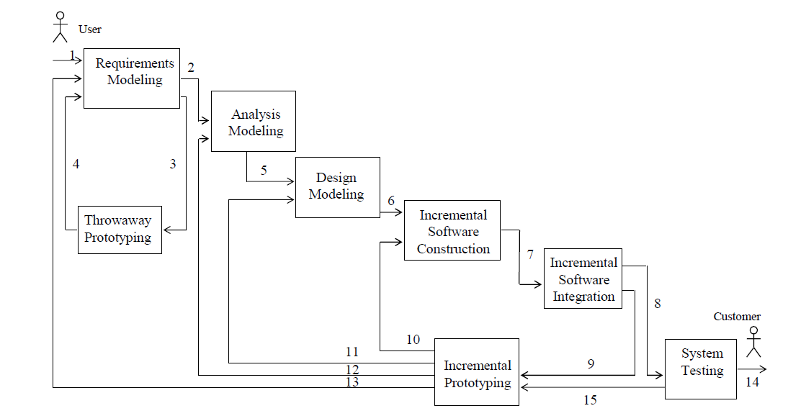
COMET object-oriented software life cycle model

Slide 5
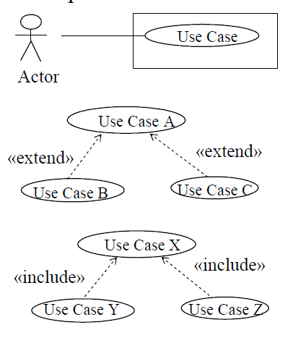
Object-Oriented Software Life Cycle
Requirements Modeling
Use Case Modeling
– Define software functional requirements in terms of use cases and actors
Figure UML notation for use case diagram

Slide 6
Object-Oriented Software Life Cycle
Analysis Modeling
Analysis Modeling consists of
Static Modeling
Dynamic Modeling
State Machine modeling using statecharts
Object interaction modeling

Slide 7
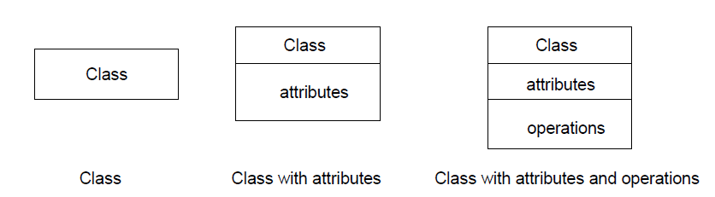
Object-Oriented Software Life Cycle
Analysis Modeling
Static Modeling
Define structural relationships between classes
Depict classes and their relationships on class diagrams

Slide 8
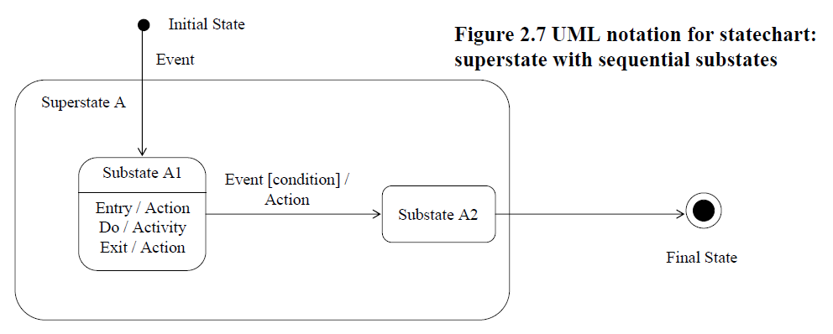
Object-Oriented Software Life Cycle
Analysis Modeling
Dynamic Modeling
– Define statecharts for state dependent control objects
UML notation for statechart: superstate with sequential substates

Slide 9
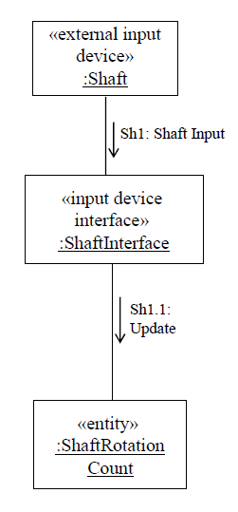
Object-Oriented Software Life Cycle
Analysis Modeling
Dynamic Modeling
– Defines how objects participate in use cases using collaboration diagrams or sequence diagrams
Collaboration diagram for Update Shaft Rotation Count use case

Slide 10
Object-Oriented Software Life Cycle
Architectural Design
Develop overall software architecture
Initially synthesize from collaboration diagrams
Structure system into subsystems
Design component based subsystems
Concurrent, Distributed and Real-Time Applications
OO concepts
Information hiding, classes, inheritance
Concurrent tasking concepts
Active vs. passive objects
Centralized vs. distributed control & data
Message communication
– Synchronous, Asynchronous, Brokered, Group
Analyze performance of Real-Time design

Slide 11
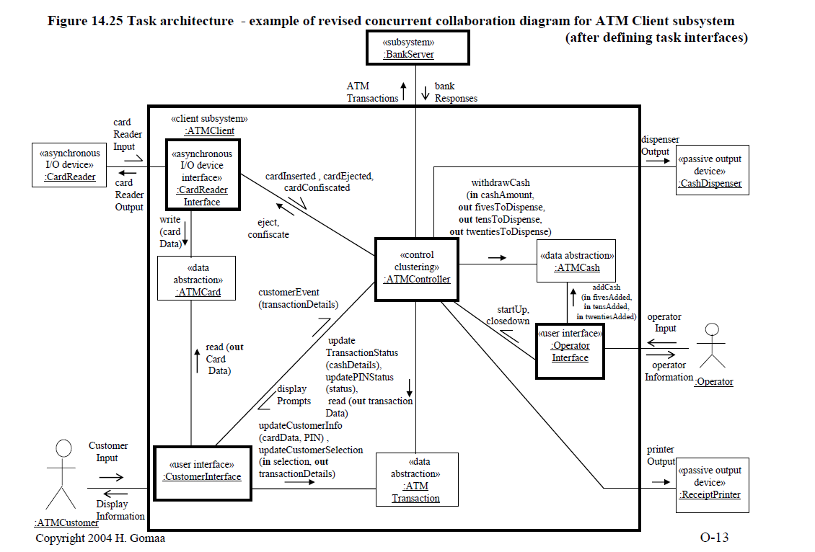
Task architecture - example of revised concurrent collaboration diagram for ATM Client subsystem(after defining task interfaces)

Slide 12
Steps in Using COMET/UML
1. Develop Object-Oriented Requirements Model
Develop Use Case Model (Chapter 7)
2. Develop Object-Oriented Analysis Model
Develop static model of problem domain (Chapter 8)
Structure system into objects (Chapter 9)
Develop statecharts for state dependent objects (Chapter 10)
Develop object interaction diagrams for each use case (Chapter 11)
3. Develop Object-Oriented Design Model
Design Overall Software Architecture (Chapter 12)
Design Distributed Component-based Subsystems (Chapter 13)
Structure Subsystems into Concurrent Tasks (Chapter 14)
Design Information Hiding Classes (Chapter 15)
Develop Detailed Software Design (Chapter 16)
Analyze performance of software design (Chapter 17)

Slide 13
Use Case Model
Define system functional requirements in terms of Actors and Use cases
Each use case defined in terms of sequence of interactions between Actor and System
Narrative description
Basic path
Most common sequence
Alternative branches
Variants of basic path
Develop use case relationships
include
extend

Slide 14
Use Cases
Identifying use cases
Consider each major function an actor needs to perform
Provides value to actor
Use case is a complete sequence of events initiated by an actor
Specifies interaction between actor and system
Use case starts with input from an actor
Basic path
Most common sequence
Alternative branches
Variants of basic path
– E.g., for error handling

Slide 15
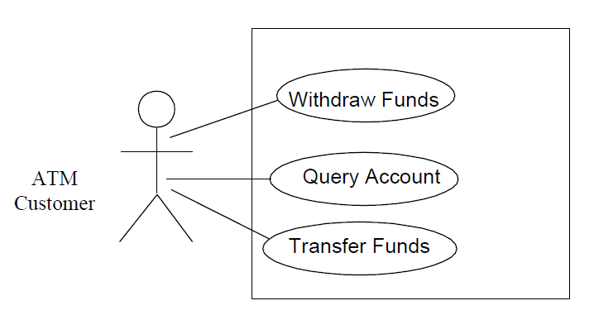
Banking System actor & use cases

Slide 16
Documenting Use Cases
Name
Summary
Short description of use case
Dependency (on other use cases)
Actors
Preconditions
Conditions that are true at start of use case
Description
Narrative description of basic path
Alternatives
Narrative description of alternative paths
Postcondition

Slide 17
Case Study: Banking System
Multiple Automated Teller Machines (ATM)
Customer inserts ATM Card
Enters Personal Identification Number (PIN)
ATM Transactions
PIN Validation
Withdraw Funds from Checking or Savings Account
Query Account
Transfer funds between accounts
Banking System maintains information about
Customers
Debit cards
Checking and Savings Accounts

Slide 18
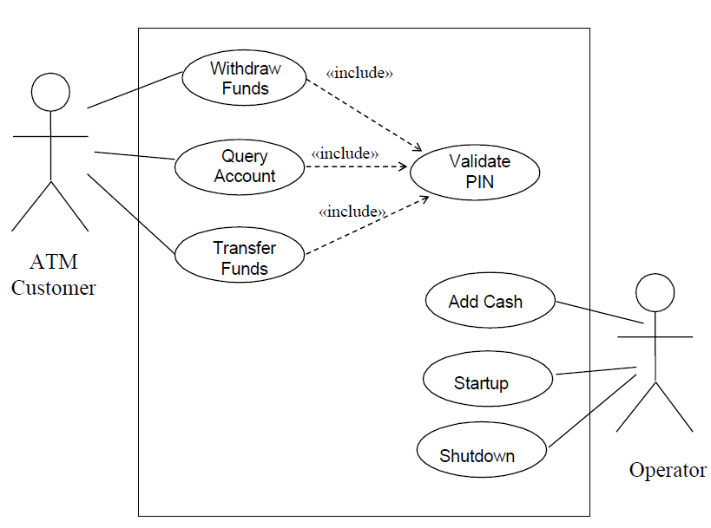
Banking System actor use case model

